Slide 1
Colonizing Sexuality
Nora Kassner
HIST 2C
Summer 2018

Slide 2
What is…
SEX
GENDER
SEXUALITY

Slide 3
What is…
SEX=A label for perceived physical differences between bodies (e.g. male, female, intersex)
GENDER
SEXUALITY

Slide 4
What is…
SEX=A label for perceived physical differences between bodies (e.g. male, female, intersex)
GENDER=what you know yourself to be (e.g. man, woman, non-binary)
SEXUALITY

Slide 5
What is…
SEX=A label for perceived physical differences between bodies (e.g. male, female, intersex)
GENDER=what you know yourself to be (e.g. man, woman, non-binary)
SEXUALITY=a term created by the comparison of your gender and the gender(s) to which you’re romantically/physically attracted (e.g. a woman attracted to a woman is gay/lesbian, a woman attracted to a man is straight)

Slide 6
Historically CONSTRUCTEd

Slide 7
Today’s Goals
See how gender and sexuality have changed over time
More specifically, understand the way in which imperial power has created categories for gender and sexuality and organized these categories into a hierarchy

Slide 8
Gender and Sexuality in 1700
Multiple gender systems exist throughout the world
In Europe, sexuality is about behavior, not identity

Slide 9
Global gender systems ~1700
Dine (Navajo):
Asdzààn (feminine female)
Dilbaa (masculine female)
Hastiin (masculine male)
Nádleehi (feminine male)
Akan (modern-day Ghana):
Gender binary, but gender roles depend on age
Ɔpanyin (senior masculinity) open to both genders
Europeans:
Gender binary, but gender roles differ somewhat from today’s
Samoans:
Tagata (man)
Fafine (woman)
Fa’afafine (non-binary)

Slide 10
Colonizing gender
Coincided with (and sometimes predated) European colonization
Reduced gender systems to a binary…
…and made both sides of this binary lesser than—and less human than—European counterparts

Slide 11
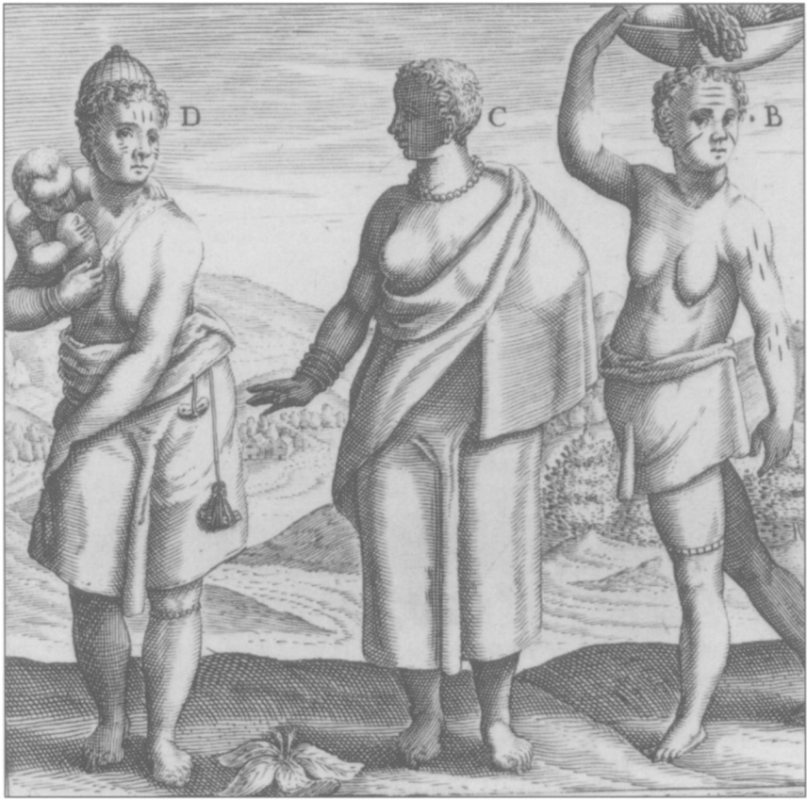
How gender colonization occurred
Forcing people to conform to a gender binary and practice European gender roles, using extreme punishments to enforce compliance
Exaggerating women’s strength and sexuality in order to justify forced labor—including forced reproductive labor
Exaggerating men’s weakness in order to justify political takeover (“enlightening” the population)

Slide 12
The creation of sexual identities

Slide 13
Sexuality in Europe until ~1900
Gender practices, not sexual identities (active/passive divide)
Who you sleep with isn’t who you are

Slide 14
But wait…what about the church?
It’s true that the Catholic church condemned sodomy
Again, this was defined as a practice—not an identity.
Punishments were rare but harsh, including execution

Slide 15
Sexual identities
Starting in the late 1800s, writers and psychiatrists begin creating the category “homosexual”
Key figures: Karl Heinrich Ulrichs and Richard von Krafft-Ebing
”Homosexual” needs an opposite, therefore…”heterosexual”

Slide 16
Heterosexuality becomes “normal”
And enforcing heterosexuality becomes an imperial project

Slide 17
In the 20th century, Fears of homosexuality served to…
Exclude people from the metropole
Prevent interracial marriage between colonizers and colonized
Crack down on dissident thought

Slide 18
Takeaways
The gender binary is not “normal”
Heterosexuality is not “normal”
Treating the gender binary and heterosexuality as “normal” reinforces imperial power structures
Distinguishing metropole from periphery
Keeping people from each separate
And allowing the imperial power to justify its actions

